Slide 1


Automatic image annotations
Image processing and computer vision
João Rocha e Melo
Javier Navarro
Cristina Luengo

Slide 2
Overview
Feature vectors
Different Features – Colours, gradients, textures
Merge the features
Clustering method
Cluster classification
Evaluation metrics (how do we compute TP, TN, FP, FN)

Slide 3
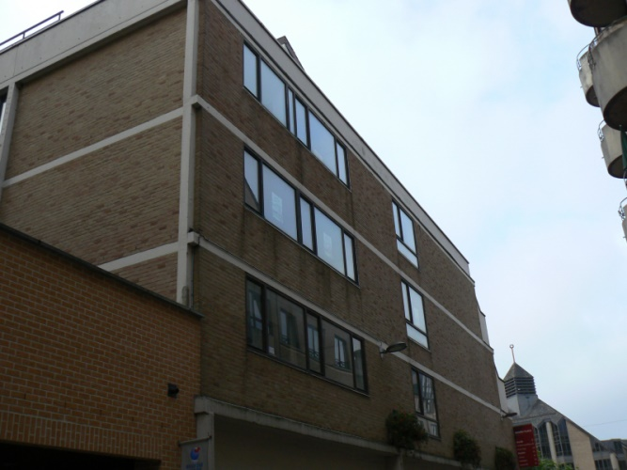
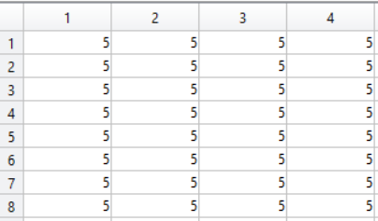
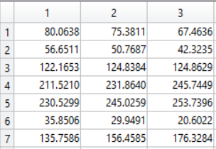
Colour
RGB
RGB to index
Index matrix
Color map
Indexes image matrix
Colour map

Slide 4




Gradients
Color Gradient Magnitude
Color Gradient Orientation
Luminosity Gradient Magnitude
Luminosity Gradient Orientation
North
West
PIXEL
East
South
$$y=North −South \\ x=West−East$$
Magnitude
$$y$$
$$θ$$
$$x$$
Orientation

Slide 5
Matching process
Option 1
Option 2
Gather the characteristics of the manually annotated points
Average vector of the characteristics
Comparison between the average vector of each cluster to the average vector of each area
Classification according to highest similarity
For each structure of the manual annotation, we calculate the percentage of points that are in each cluster
Classification according to the highest percentage

Slide 6
Evaluation process
Given a structure of the manual annotation and the cluster corresponding to that area:
TP = Points present in the manual annotation and in the cluster
FP = Points present in the cluster and in another structure from the manual annotation
TN = Points not present in the manual annotation (present in the other structures) and not present in the cluster (present in other clusters)
FN = Points present in the manual annotation and in another cluster different from the one we're looking

Slide 7
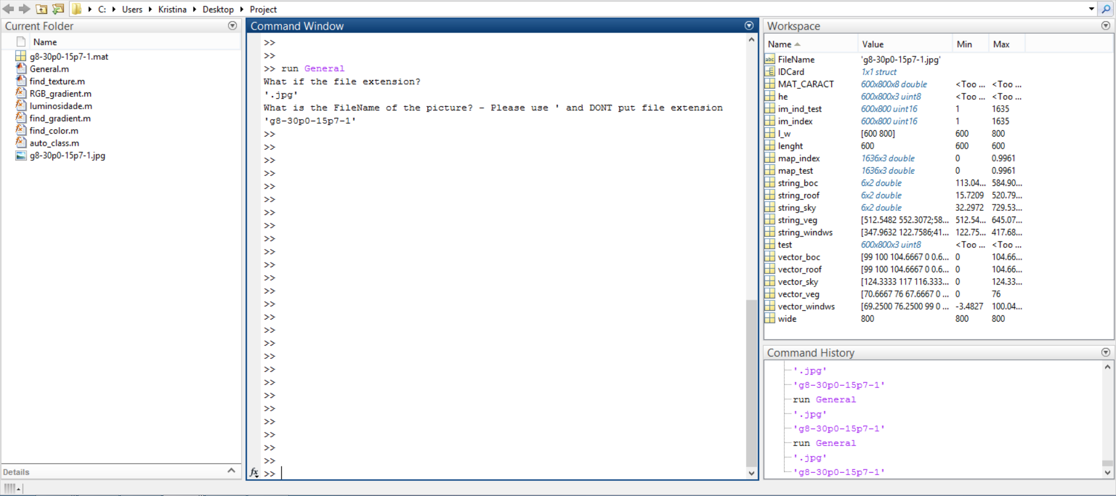
First results

Slide 8
Future planning
Addition of features
Texture
Region based segmentation
Region growing
Clustering method

Slide 9
Textures
Texture Contains a narrow range of frequency and orientation components
Input image
Filter bank
Gabor filters
Response image
treatment
Feature extraction
Feature image

Slide 10
Future calendar
November 3rd: Clustering method, texture characteristic
November 10th: Clustering method, texture characteristic
November 17th: Cluster gathering
November 24th: Cluster gathering, evaluation
December 1st: Evaluation and testing
December 8th: Editing the report and commenting the code

Slide 11
Thank you
Questions?

